Slide 1

NLP Coders

Slide 2
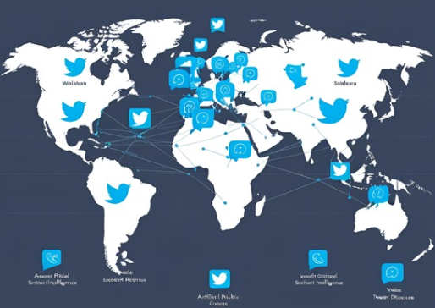
Using AI to Decode Public Voices on Global SDGs
A real-world analysis of 5 SDG areas using live Twitter data.
Applied NLP & AI to uncover what people say, feel, and want.
Aimed at helping decision-makers shape more responsive, inclusive policies

Slide 3
Meet the Team – Data-Driven Storytelling Across Five SDGs
Team Member | SDG Focus | Theme
Shehan | SDG4 – Quality Education | Equity, Digital Learning
Sanidu | SDG1 – No Poverty | Basic Needs, Support Systems
Qui | SDG5 – Gender Equality | Rights, Safety, Representation
Jackie | SDG12 – Consumption | Sustainability, Waste
Alvin | SDG16 – Justice & Peace | Institutions, Trust, Policy

Slide 4
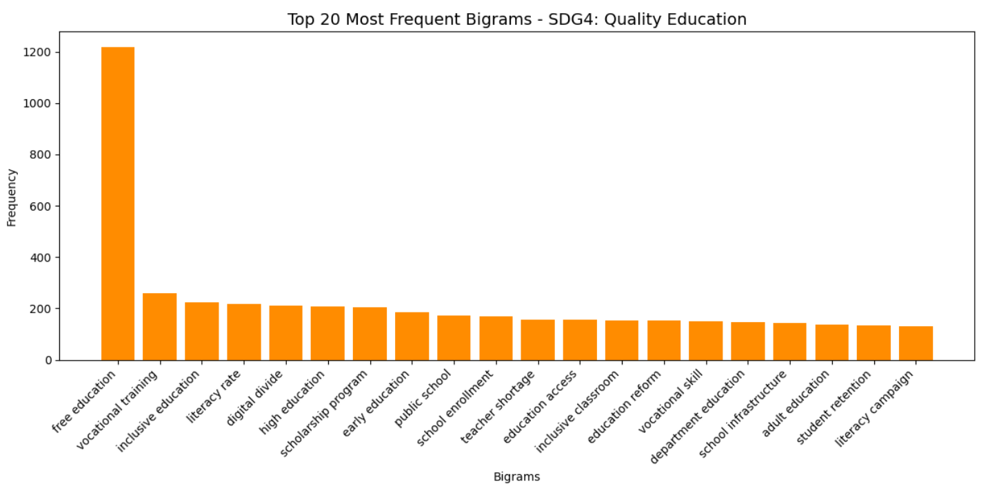
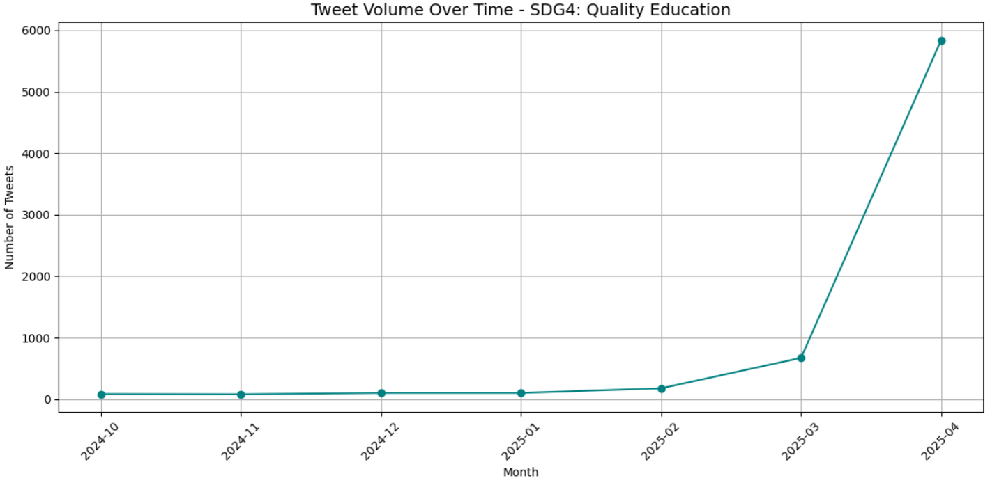
Quality Education
The World Is Demanding Free, Future-Ready Education — Loudly and Timely
“Free education”, “vocational training” lead trends
Public demands career-aligned learning access
April 2025: peak in tweet volume
Spike aligns with UNESCO education campaign

Slide 5
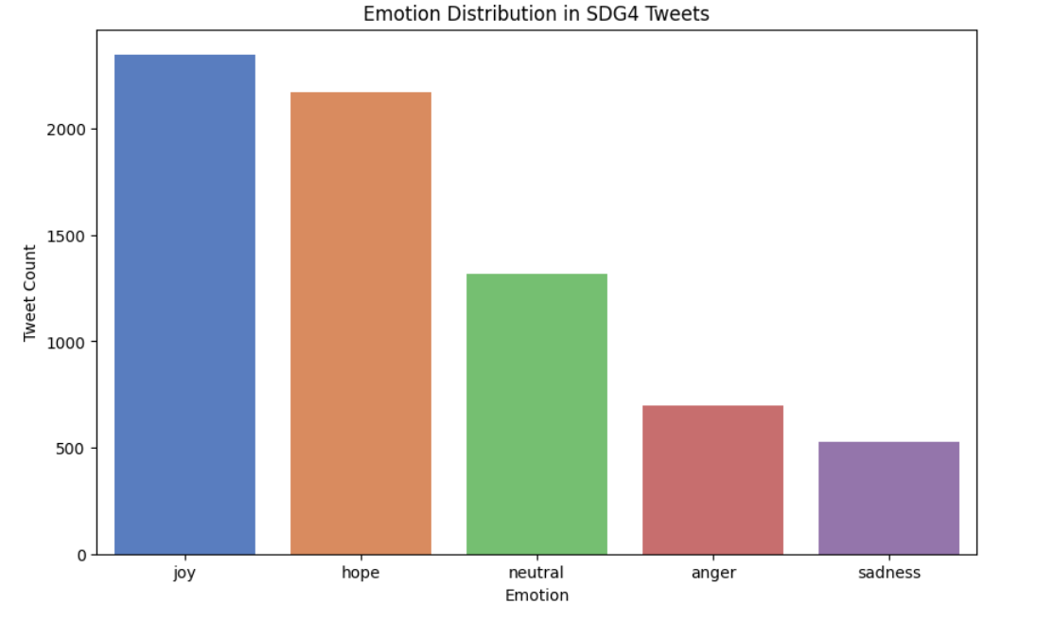
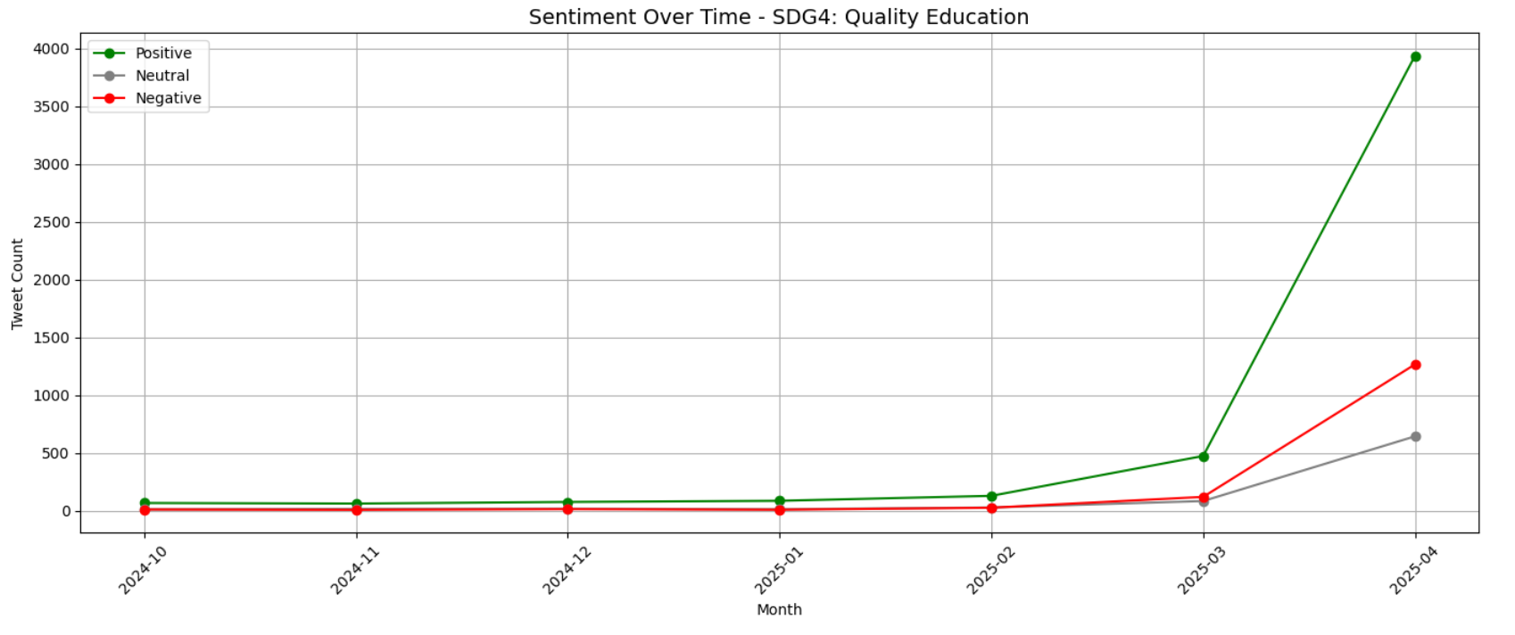
Quality Education
Public Hope Is Rising — But So Is Anger. Are We Listening?
Positive sentiment spikes in April 2025.
Joy and hope lead emotional tone.
Anger, sadness tied to key issues.
Highlights need for inclusive policy shift

Slide 6
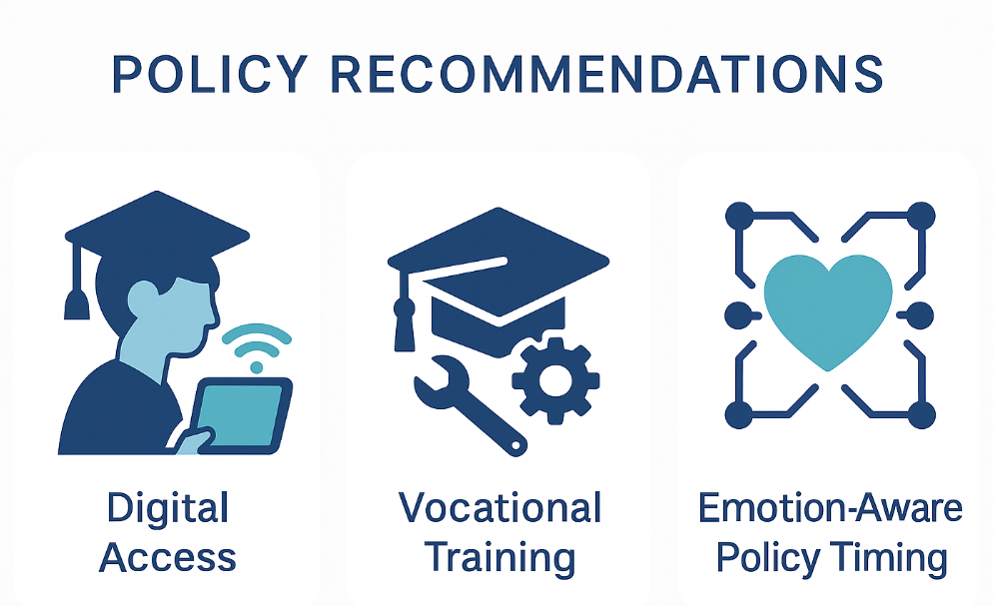
From Voices to Action: Three Ways to Deliver on SDG4 Now
Quality Education
Boost Access
• Subsidize digital inclusion programs
• Bridge tech gaps in remote regions
2. Skill Up (Supports SDG4.3)
• Expand vocational & career pathways
• Promote affordable tertiary education
3. Time Smart
• Track emotion trends via AI
• Launch reforms during peak engagement

Slide 7
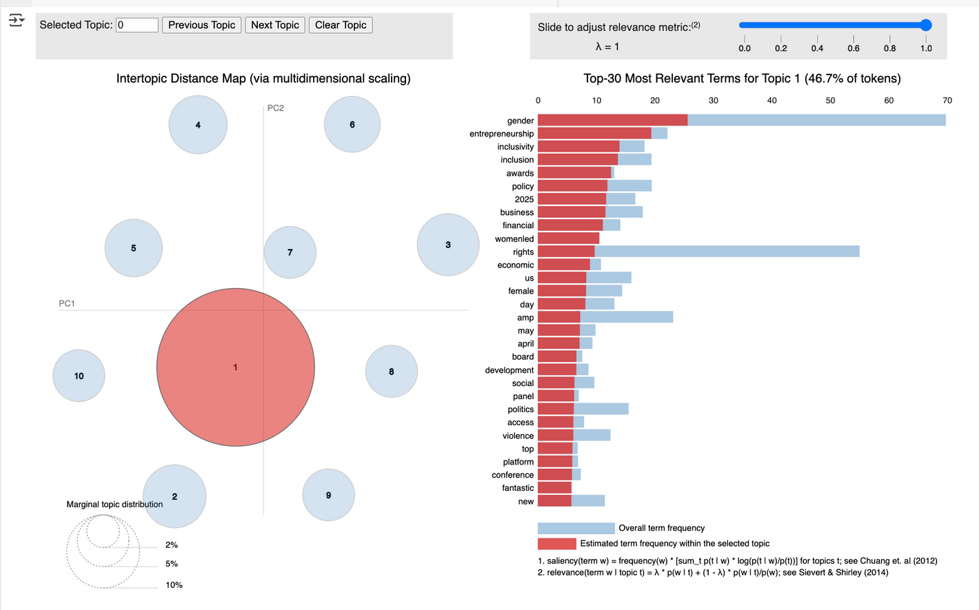
Gender Equality
Focus on Empowerment, Reform, and Key Events
Economic empowerment dominates: Terms like “gender”, “entrepreneurship”, and “inclusivity” show strong focus on women’s financial inclusion and leadership.
Structural reform & safety: Frequent words such as “policy”, “rights”, “violence” reflect public demand for institutional change and protection of women.
Event-driven engagement: Mentions of “May”, “April”, “day” hint at spikes around key global events like International Women’s Day or major gender policy announcements.

Slide 8
How Can Governments Accelerate SDG5 Using Public Discourse Insights?
Gender Equality
Boost economic inclusion
Enforce gender equity in leadership
Governments should fund women-led businesses to improve access to finance and support SDG5 Target 5.a.
Implement gender quotas and inclusive hiring to support SDG5 Target 5.5 on equal leadership and decision-making.
Pair empowerment with protection
Leverage global awareness events
Integrate violence prevention into empowerment efforts to support SDG5 Target 5.2 on eliminating violence against women and girls.
Align gender campaigns with key dates like International Women’s Day to boost impact and support UN SDG5 mobilisation.

Slide 9
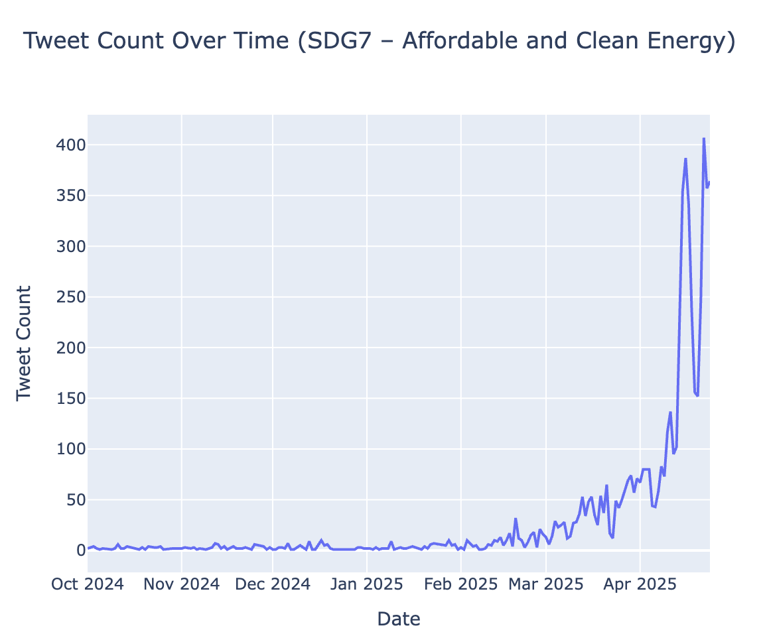
Tweet Volume
Consumption

Slide 10
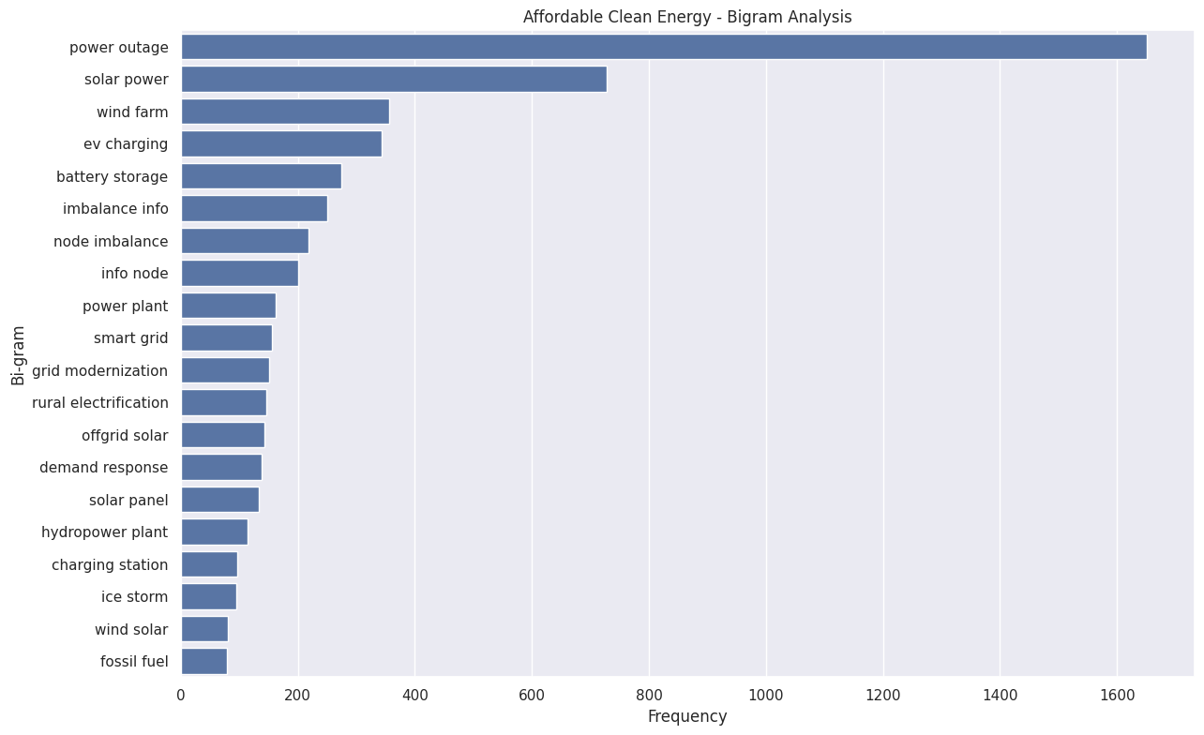
What are people talking about?
Consumption
Notes:
From the deeper analysis, we have found that common tweet discussions revolve around issues like power outages, node imbalance, ice storms, as well as some issues abou energy storage, and ev charging
It seems like the most common clean energy sources being discussed are solar and wind energy, hydrower plant

Slide 11
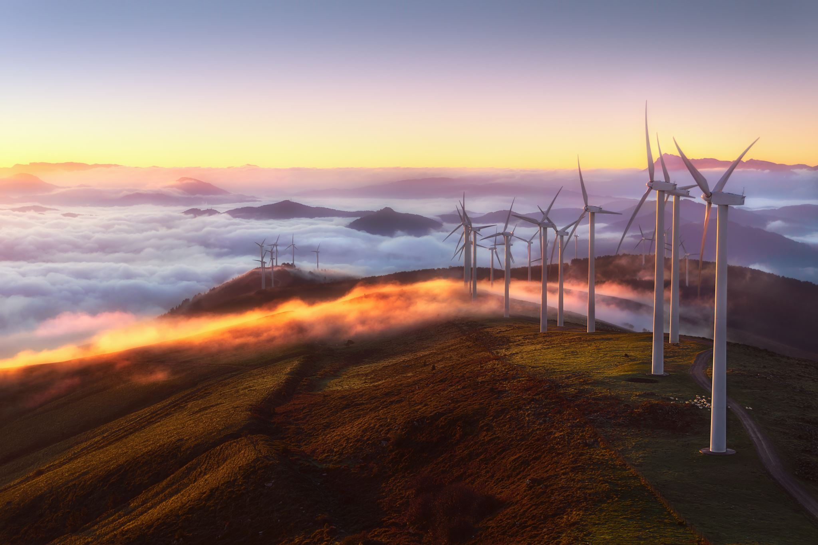
Key conversations
Consumption
Challenges and disruptions in the energy landscape
Power outages and grid vulnerabilities
Energy infrastructure, equity and renewable transition
Technology innovations
Notes:
Topic 1 represents discussions about energy infrastructure management, with emphasis on grid reliability, solar initiatives, efficiency projects, and energy justice. Conversations also mention responses to power outages and planning efforts by states or companies, often linked to equity and accessibility concerns
This topic focuses on digital innovation and energy transition efforts, particularly in regions affected by vulnerability—be it climate disruption or energy poverty. It shows strong associations with smart grids, off-grid solutions, and digital electrification projects. The inclusion of terms like billion, fund, and project implies that investment and funding are central to these developmentsIt also reflects an urgency to improve access (access, electrification) and response to crises (flood, response, injury), especially in locations like Kenya, Southeast Asia, and Queensland
This topic captures narratives of power grid failures and emergency responses, particularly those due to external events like strikes, extreme weather, or accidents. The presence of terms like blackout, impacted, switching, and solar also hints at energy system fragility and the growing importance of solar backup or distributed energy alternatives.
It highlights how vulnerable populations (e.g., patients, metro riders, beachgoers) are affected by unplanned outages, underscoring the need for resilience planning
5. This topic revolves around systemic challenges, incidents, and risks affecting the energy transition. The inclusion of shortage, aging workforce, and incident indicates structural issues in the energy supply chain. Terms like ai, drone, and tesla point to emerging technologies and energy innovation, while war, iraq, and copper suggest geopolitical risks and resource constraints.
It also brings in public discourse and policymaking (txlege, reporting), possibly reflecting how these challenges are discussed in media or government platforms

Slide 12

Actionable insights and recommendations
Consumption
Ensure energy equity and rural electrification
Targeted rural electrification programs with community participation
Strengthen grid resilience and outage management
Smart grids systems, weather-resilient technologies, and emergency response protocols
AI
Promote renewable energy adoption
Fund decentralized renewable projects
Invest in energy storage solutions
Accelerate EV and charging infrastructure development
Smart charging programs

Slide 13
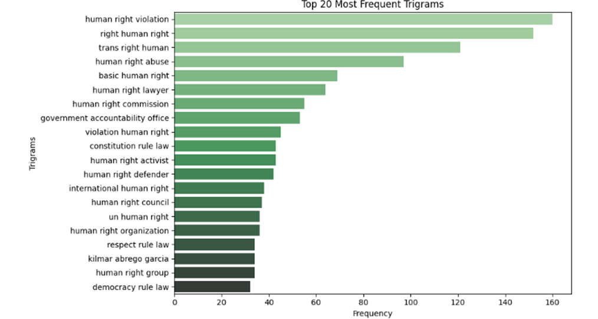
Justice & Peace
What’s everyone talking about?
“Human rights violation” & “commission human rights” suggest a formal or global-scale crisis.
“Protect trans rights” & “trans gender rights” point to gender identity inclusion—another emotionally charged theme.
“Government accountability office” indicates demand for institutional responsibility.

Slide 14
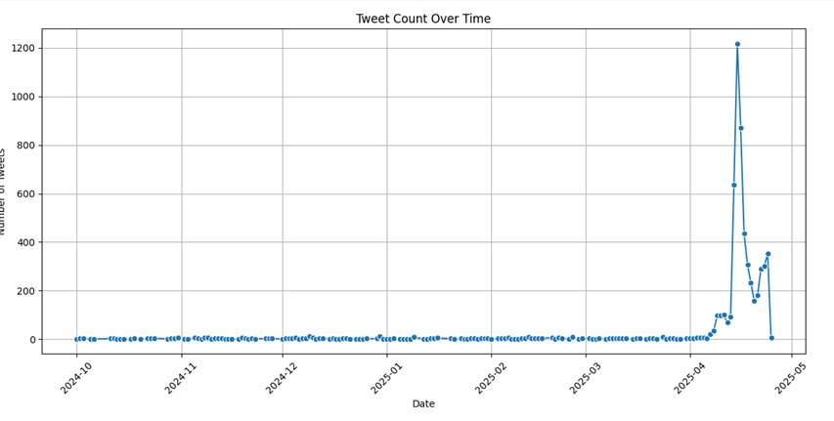
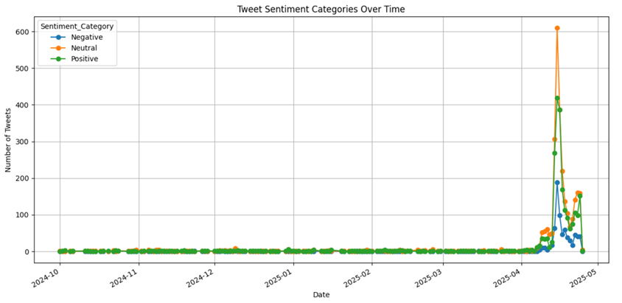
Echoes of Emotion Over Time
Justice & Peace
📈 Spike in Engagement
Tweet volume surged mid-April 2025, crossing 1,200 tweets/day.
Indicates critical human rights event that drew widespread public attention and emotional backlash.
😠 Drop in Sentiment
Sentiment turned sharply negative in the same period.
Reflects strong public backlash or emotional response.
🔄 Sustained Public Interest
Tweet count remained high even after the peak.
Despite a drop after the peak, tweet counts remained above normal, showing continued public interest and concern.

Slide 15
What Should Be Done Next?
Justice & Peace
Governments
Address public backlash swiftly with clear communication and accountability steps.
Enact stronger protections for transgender rights and marginalized communities.
United Nations
Launch investigations where human rights violations are most reported online.
Partner with local NGOs to reflect on-the-ground realities.
Policy Makers
Hold public hearings to restore trust in
government accountability.
Update national human rights strategies with focus on inclusion and digital rights.
Fund awareness campaigns on rights and misinformation.
Public & Advocacy Groups
Promote respectful, fact-based advocacy to drive constructive discourse.
Use petitions and FOI (Freedom of Information) tools to demand transparency and justice.

Slide 16
Cross-SDG insights…
Recurring themes of accountability, inclusion, and urgency across most, if not all, SDGs.
Spikes in user Tweets around April suggest that this time frame is better to release reports, policy updates, etc.
Data-driven insights reveal frustration around slow, top-down approaches, especially in global advocacy contexts.
… and final policy recommendations
Effective delivery depends on localizing global programs to ensure trust and community ownership.
Expand digital access and financial inclusion infrastructure to meet growing demands voiced across multiple SDGs.
Use real-time public emotion and intent signals to prioritize and personalize SDG-related actions.

